Slide 1
Early Learning subcommittee
May 25, 2023
Notes:
Intro Chair:
Early Learning Officer
Chair to support preschool parent engagement and build awareness of the importance of preschool education.
Zoom Control panel – hover over for:
microphone mute-unmute camera on-off icons raise hand, chat,
Recording Zoom meetings are recorded and transcribed for minutes
Contact I’ve added my contact details to the chat ------------ Marina Spurgin m 0401 838 872

Slide 2
Notes:
Yuma
I acknowledge the Ngunnawal and Ngambri people as the traditional custodians of the Land on which we meet, and recognise it has never been ceded.
I pay my respects to the Elders, past present and emerging.
I welcome everyone here and invite you to introduce yourselves and tell everyone a little about your parent association or why you’re here
Or just wave if you’re not in sharing circumstances
starting with…

Slide 3
P&C Council
EL Officer Email (Marina):
earlylearning@actparents.org.au
early learning links
Facebook:
https://www.facebook.com/ACTParents
Web:
Early Learning - Information for P&Cs (actparents.org.au)
ELSC meeting minutes & registration:
summaries and registration
Notes:
Council: peak body for parent associations in ACT public schools.
ELSC Committee Background
Council’s Early Learning Subcommittee (ELC) was established in 2018 to continue the work of Canberra Preschool Society (1943-2018). Representing the parent voice, promoting the importance of preschool education, and supporting parent engagement in public education.
Council's early learning subcommittee provides a forum for EL parent communities in ACT public schools. The committee promotes the benefits of quality early learning and parent engagement, and advocates for parents, carers and public education.
Council have been representing parent and community views on public education to Government since 1954.
through:
consulting with public school parent and community groups -- to identify issues and ideas for improving public education
communicating with decision makers and contributing to policy development -- inviting parent reps to participate in consultations and discussions with Gov
strengthen EL parent communities,
promote parent engagement, and
advocate on behalf of families and schools for the benefit of our children's education and wellbeing.
ACT preschool and kindergarten education and parent participation in their children’s education.

Slide 4
Agenda
Early Learning activities and events
Enrolment & School Readiness – early engagement
Grant templates at the ready – parent associations
EL Sector updates – CECA, ACECQA, Budget
Council ELSC budget
Notes:
emailed with the ELSC budget attached prior to the meeting

Slide 5
Events - Significance
Significant days in June
1 June – United Nations Global Day of Parents
3 June – Mabo Day
5 June – World Environment Day
8 June – World Oceans Day
18 – 24th June – Water Safety Week
21 June – Make Music Day
Parent Associations with early learning communities use events to engage community
Share your stories – invite others
Notes:
Events can help engage families
ie
National annual events: Repeat, can leverage exposure and use their communication resources (sometimes funding too)
Not everyone’s familiar with an event or what it means… and, it’s easy to take for granted familiar celebrations. D
Discussion
how P&Cs use events to help engage families. How committees can share their stories about the significance of events within their own families.
sharing something about yourself is an important precursor to inviting communities to share their stories.
Sharing stories helps build communities.
share a story about what an event means to me, about why I value - cycling to school, playing in the mud, grandparents,..
Sharing stories about community values
anonymous or otherwise depending on willingness.
takes time, planning, communication and trust.

Slide 6
Events - Example
Children’s Week (October)
Children’s Week shareable resources
Childsafe Organisation training information
practical tools for Childsafe organisations
Checklist for online safety,
Guide for parents and carers (child safe orgs)
Safety and Wellbeing Policies and Practices
Notes:
National events have resource pages and letter templates (event links included in the content planner).
For example
Children’s Week
Annual themes - 2023 UN article on children’s right to rest and safety
One primary school invites next year’s enrolled starters to their bookweek event

Slide 7
Events - repetition - Preparation
Important annual EL dates
The benefits of repetition for P&Cs and parents
Try different approaches, utilise expertise,
Build on previous effort
Update technology, process, and records
File photos and feedback for passing forward
Evaluate for next year
Prepare
pre-plan messaging in advance (in order to)
give time to request feedback from community and committee, and
automate advance scheduling of messaging (delegate if possible)
See pre-filled Content Planner for Early Learning
Notes:
Repetition of annual events:
Accumulate annual records of celebrations to share
ie ‘five years of [association] celebrations’ in images.

Slide 8
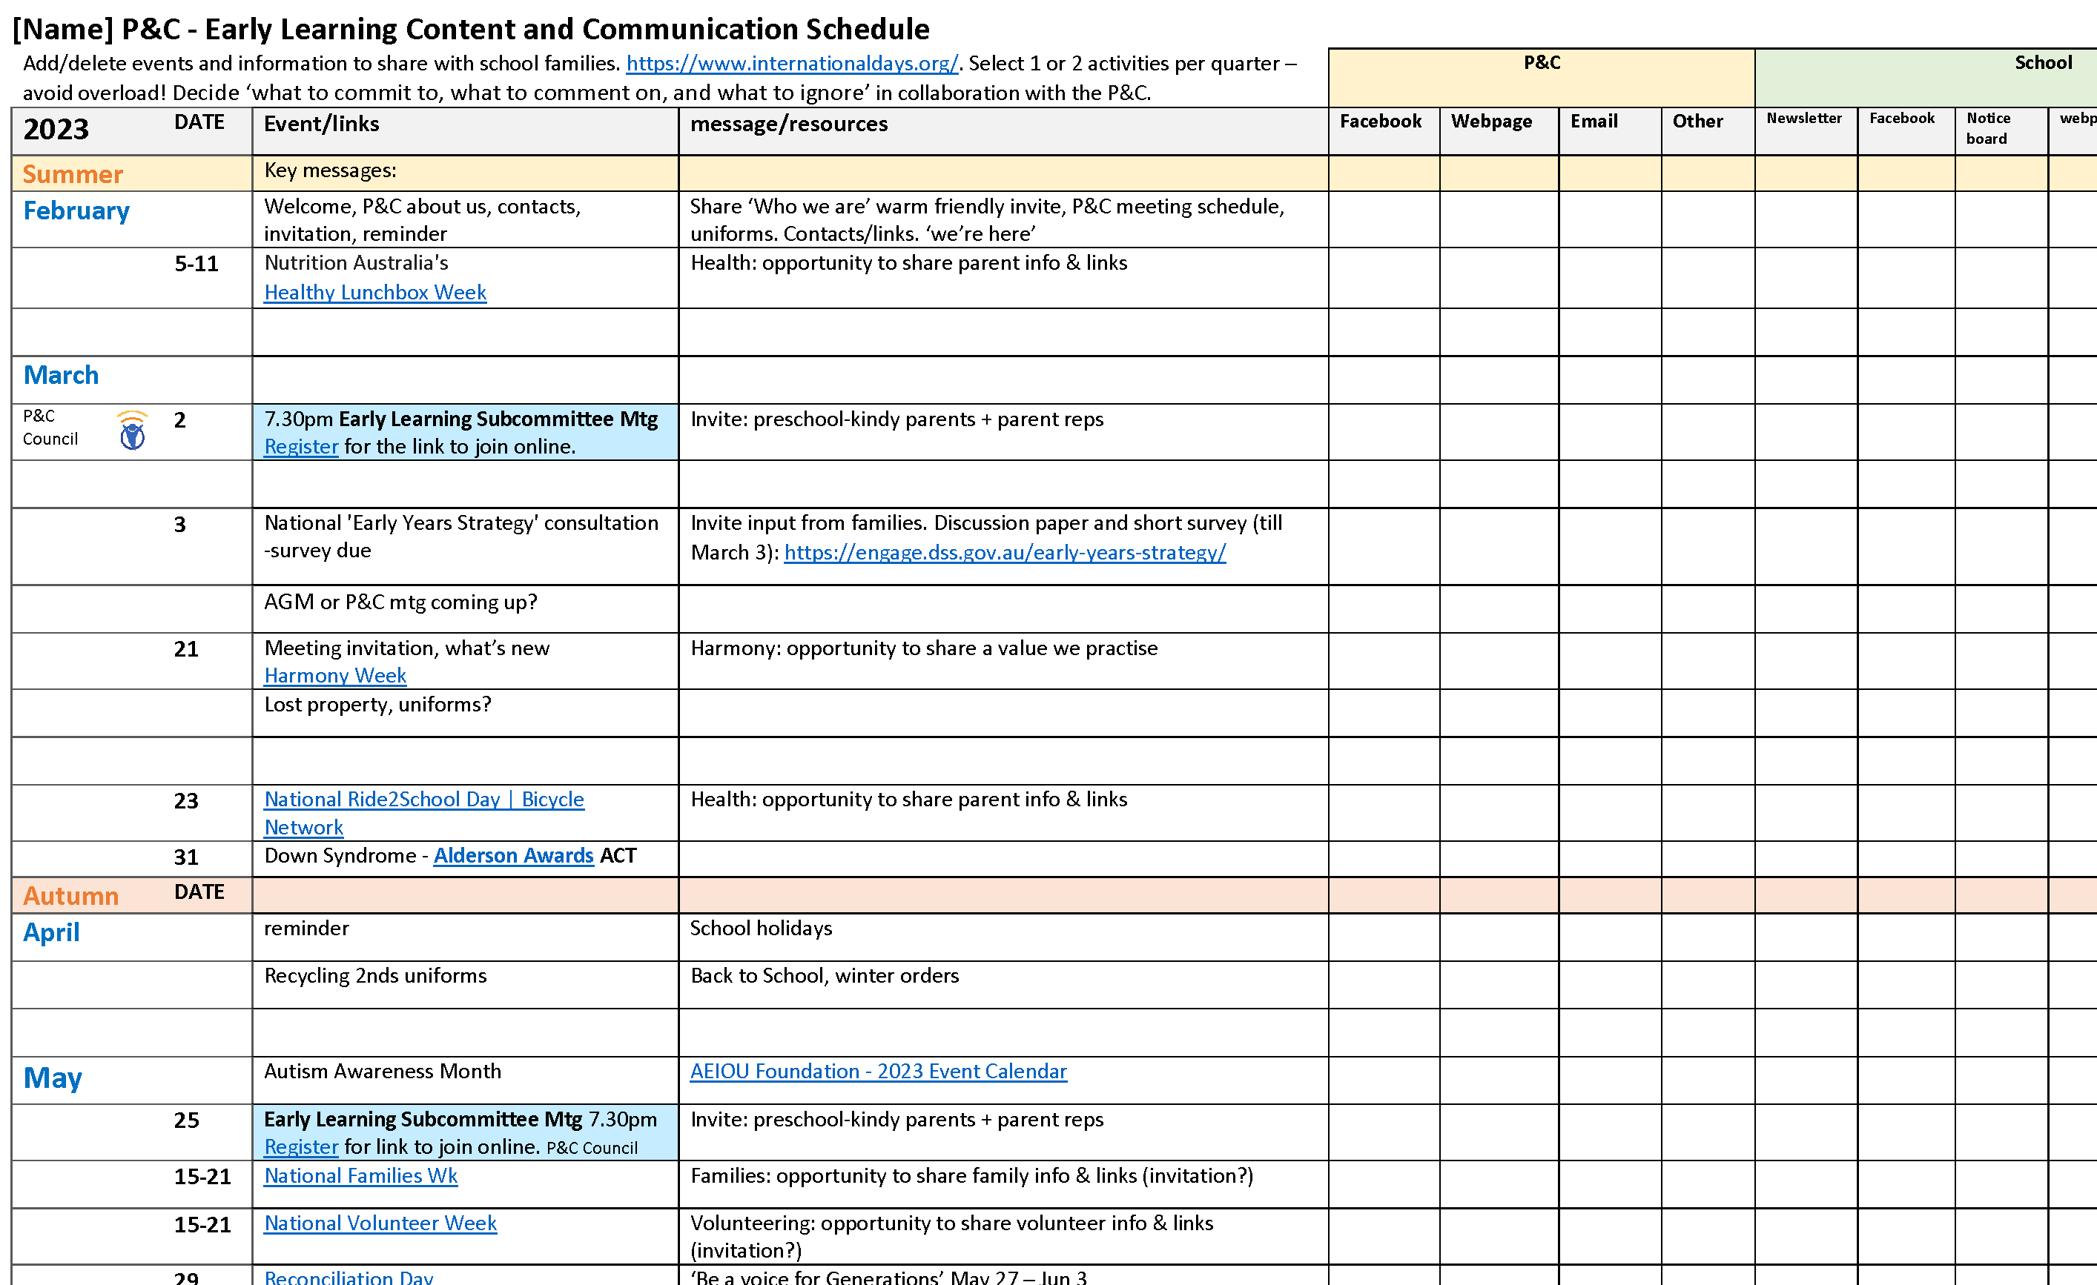
Events - Content plan
You choose what to act on, comment on, share, or ignore
Notes:
Annual planning guide - Prints to A3 - customisable. Add your own plans.
Digitised applications available ie Facebook or Canva (recommended)
Education seasons and actual seasons:
The start, middle, and end of the year have different priorities for staff, students, and parents.
Enrolment, orientation, transition, first/last days of term or school year.
The first day of winter is hats off day (gets a lot of attention via social media)
Seasonal uniforms, sports, impacts.
Q.
What national events do you celebrate in early learning?

Slide 9
Enrolment & School Readiness
Preschool Enrolments opened late April (Due June 2)
Support by
Share the message (Facebook/newletter)
Provide information Early Learning - Information for P&Cs (actparents.org.au)
Start a conversation ‘how did you find -the enrolment process? the first week of school? -settling into school?
Notes:
Preschool enrolment and school readiness
How P&C’s support EL parents around enrolment.
Share the message about enrolment dates and enrolling online
Importance of the deadline for first offers – later confirmation of preschool location means fewer OSH options, less time to prepare
Target: Parents/carers of 2-3 YO’s - Children turning 4 by April 30, 2024
still apply if the first deadline is missed.
Q. Have any questions about enrolment?
There may be questions in your EL communities.

Slide 10
School Readiness
Is my child ready for school?
What’s the most important skill for a preschooler to learn?
How do you prepare for new families?
Raisingchildren.net.au
https://www.actparents.org.au/index.php/early-learning/information-for-p-cs
Notes:
School Readiness
Parents regularly ask about school readiness during transition to school. The term can add to the pressure of parenting young children.
Depending on your EL community, can provide an opportunity to engage with parents and start a conversation, or a good resource to have available.
What’s the impact of these questions? There’s a lot of variance in the answers.
Can you help us to be ready for your child?
Raisingchildren.net.au provides concise information about preschooler development and reliable links to further information.
3-4 yr development, 4-5 yr development, and developmental delay and what to do.
Are you ready for preschool?
Are you ready for kindergarten?
The lifting Our Game review report is focussed on EL.
Q. What resources do you provide during orientation?
There may be questions in your EL communities

Slide 11
Early Learning Grant template
Grant application basics auto-fill template
Notes:
Grant templates for P&C EL activities
Grant application basics pdf.
Grant workshop free training
EL grants template.
grants have to be implemented and aquitals written based on the application so be sure to KEEP a copy of the application and incorporate it into the acquittal.
Ensure that what’s applied for is implemented.
Some grant Funding sources and Federal funding in the pipeline
2023_PC_grant_app_template.pdf (actparents.org.au)

Slide 12
Early Learning Sector
The National Children’s Education and Care Workforce Strategy (2022-2031)
ACECQA website
ACT Alliance for Evidence-Based Education
NAPCAN
National Botanic Gardens
Notes:
In relation to ‘The National Children’s Education and Care Workforce Strategy (2022-2031)’
Current consultation (May, June and July) will inform options for governments to consider at the end of the year.
More information about this important review is available on the ACECQA website: http://www.acecqa.gov.au/review-nqf-staffing-and-qualification-reg
National Reconciliation Week from 27 May to 3 June Approved learning frameworks
In early 2024, all services will be required to implement Version 2.0 of the approved learning frameworks*:
Belonging, Being and Becoming: The Early Years Learning Framework for Australia (EYLF V2.0)
My Time, Our Place: Framework for School Age Care in Australia (MTOP V2.0)
Literacy
https://www.canberratimes.com.au/story/8183501/new-alliance-calls-for-literacy-overhaul-in-act-public-schools/
The ACT Alliance for Evidence-Based Education has put in a submission to the 2023-24 territory budget and presented at Council’s last GM. The education directorate will reply at the next Council meeting.
It is also calling for a universal year 1 phonics screening check and new decodable reading books for students in kindergarten and year 1.
NAPCAN

Slide 13
Training
2023
Treasurers' and Insurance Workshop To meet all your P&C obligations and regulations.
Tue 30 May 7:00-9:00 pm (Week 6, Term 2)
P&C Constitution workshop ​ Bring along your own P&C constitution to work on​
Wed 14 Jun 7:00-9:00 pm (Week 8, Term 2)
Grant Writing workshop
Fund your good works! Recording, researching, applying and acquittals
Tue 5 Sep 7:00-8:30 pm (Week 8, Term 3)
Financial Review workshop
Help for treasurers (or aspiring treasurers) to prepare P&C accounts for the annual Financial Review. A legal requirement for all P&Cs.
Tue 24 Oct 7:00-8:30 pm (Week 3, Term 4)
Recordings can be requested​ from contacts@actparents.org.au
Notes:
Supporting P&Cs with responsive training
Capacity building training
Administering online networks/meetings
Surveys and results, community listening
Unpacking the Australian Early Development Census
Creating your P&Cs annual calendar

Slide 14
Thank you! Yarra
Marina Spurgin
Early Learning Officer ACT Council of P&C Associations
0401 838 872
Notes:
earlylearning@actparents.org.au

Slide 15
Who benefits from effective family-school-community partnerships?
Notes:
Book Karen Mapp

